Slide 2
CARTOGRAPHY

Slide 3
Cartography
Contents
Introduction
History
Revolution in cartography
Definitions
Scope of cartography
Cartography and surveying
Cartography and GIS
Maps
Need of maps
Classification of maps
Map scale

Slide 4
Introduction
For any development tasks to be formulated, scheduled and implemented, we need information.
About 70% of the information includes some spatial facts in decision making.
Better information certainly leads to better decision.
Most effective way of sharing spatial information (communication) is through graphics ( than other verbal or written language, tables of number) – most effective graphics are maps.
Cartography is associated with graphical presentation of spatial information ( map)

Slide 5
Introduction
Certain amount of information may loss in studying, selecting and generalizing the data to present in the form of maps and do not reach up to the user.
Cartographers , so, must be very dynamic to bring out up to date information to the map user.
Cartographers should always have interactions with the map users and get feedback from them so that better maps can be produced next time.
All aspects of map making and map using are dealt with under the subject of cartography.

Slide 6
History of Cartography ( before 1960)
Manual mapping procedures were dominant during the longest period in the recorded history of cartography.
people used to use brushes, quills etc on medium like papyrus, silk and even clay and metal. Oldest map found in clay tablet ( nearly 5000 year) showing mountain, water bodies, and other geographic features in Mesopotamia.
demand of skillfully made charts of coastline and other navigational instruments emerged in the 14th and 15th century made the map making a recognized profession. Maps in land are rather poor.
People used wooden cuts and intaglio copper plates.
In 1571, theodolites developed and map accuracy increased due to accurate surveying.

Slide 7
History of cartography
Gerhardus Mercator devised in 1569, a map projection- Mercator Projection- considered to be father of cartography. Mercator used the term “Atlas” for volume of maps
With the invention of chronometer for keeping accurate time and the theodolite , latitude and longitude were accurately determined in 17th century.
lithographic and wax engraver developed in the 19th century. The development of photography and application of etching techniques were major technological development in cartography

Slide 8
Revolution in Cartography
Meaning of cartography has changed fundamentally since 1960 – by advent of computer.
Earliest mapping applications implemented on computer in 1960 ,however, are limited in few governments and academic projects as early computers are not good for complex structures like maps and large data storage capacity.

Slide 9
Revolution in Cartography
After1980s, commercial Geographic Information System helped digital mapping to reach a higher level of capability.
Better database software – allows the management of vast amount of data
Computer graphics techniques provide the data models for storage, retrieval and display of geographic objects.
Advanced visualization techniques allow us to create increasingly sophisticated representations of our environment.
fast, high-resolution scanning and sophisticated software speed up map data conversion that previously relied exclusively on manual digitizing.

Slide 10
Revolution in Cartography
The GPS has revolutionized field data collection, new generation of commercial, high resolution satellites promise pictures of any part of earth surface to support numerous mapping applications.
Internet on the WWW has applied for Data dissemination to replace printed maps and digital media.

Slide 11
Definitions (old)
The word cartography is derived from Greek word Carte-graphine (in Greek CARTE = "an empty plane paper to write or to draw and GRAPHINE = "to draw with mathematical accuracy ) is the study and practice of making maps or globes, or art and science of making maps.
The science of map making and includes all the operations from the completed pencil-drawn base map to the final printing of copies. ( based on two centuries old tradition of surveying and mapping )

Slide 12
Definitions (old)
The science of preparing all types of maps and charts and includes every operations from original survey to final printing of copies. (Adopted in 1948 by the committee of experts on Cartography of the Economic and Social Council of UN).
The art, science and technology of making maps together with their study as scientific documents and works of art. In this context, maps may be regarded as including all types of maps, plans, charts and sections, three dimensional models, and globe representing the earth or any celestial body at any scale. ( definitions adopted in 1966 by commission I of experts of ICA )

Slide 13
Definition ( new)
Cartography now a days is seen as the conveying of geospatial information by means of maps.
Computer and GIS influenced definition was given by Guptill and Starr, 1984 – the information transfer that is centered about spatial data base which can be considered in itself a multifaceted model of geographic reality. Such a spatial data base then serves as the central core of an entire sequence of cartographic processes, receiving various data inputs and dispersing various types of information products.

Slide 14
Definition ( new)
Tayler( 1991) defined cartography as “ the organization, presentation, and utilization of geo-information in graphic, digital or tactile form. It can include all stages from data preparation to end use in the creation of maps and related spatial information products.
Kraak and Ormeling ( 2003) defined cartography as: making accessible spatial data, emphasizing its visualization, and enabling interaction with it, aimed at dealing with geospatial issues.

Slide 15
Scope of cartography
Until the recent past, cartography solely about preparation of maps.
Map users depended on that generalized information put on the maps by cartographers where the information was equally controlled and limited by the technological limitation.
Now a days, digital technology makes map making process very fast and easier. Better maps are produced as per the demand of the users within few minutes.

Slide 16
Scope of Cartography
To promote standard system of data capturing, storing, processing and visualization, cartographers became familiar with all these mapping activities including those associated with the other mapping sciences ( Geodesy, Surveying, Photogrammetry , Remote Sensing and GIS)
To understand the needs of map users from variety of fields to satisfy them, cartographers must also know about human thought and communication and disciplines associated with the environmental features to be mapped as well to produce meaningful maps.

Slide 17
Cartography and Surveying
Cartography has a very close relationship with surveying as cartography, logically, comes after the works of surveying.
Maps helps surveyors to schedule their tasks, proper locations of control points to be established and work out optimum route of surveying.
Aerial survey planning can not be properly started without maps.
Graphical surveying like cadastral surveying and topo-surveying require knowledge of detailed cartography.

Slide 18
Cartography and GIS
An organized collection of computer hardware, software, geographic data and personnel designed to efficiently capture, store, update, analyse and display all forms of geographically referenced information is popularly known as GIS.
Basically GIS consists of 3 components- data, processing/analyzing and output facility. GIS data are collected from existing maps or other sources which are cartographically meaningful for storage, analysis, and presentation.

Slide 19
Cartography and GIS
Cartographic knowledge helps the GIS user to develop the correct algorithms for processing and analyzing.
The output of GIS is eventually used by decision makers – should be presented in such a way that the decision makers understand the phenomenon correctly and appropriate decision be made.

Slide 20
Maps
“A graphic model of the geospatial aspects of reality.”
According to French cartographer the map is, “a conventional image, mostly on a plane, of concrete or abstract phenomena which can be located in space.”

Slide 21
Maps
Globe is one of the most perfect representation of the earth, however, not convenient to use for different purposes such as linear measurements, carrying one place to another.
It is practical to represent the features of the earth onto the flat surface like a paper.
The reduced and generalized, in a scientific way, representation of the whole or part of the earth onto a flat medium (generally paper) is called a map.

Slide 22
Need of map
Map gives an overview of an area. And map is the only way to get overview.
A map places geospatial data in their correct relationship to one another.
Map can be considered as geographic information system that gives answers to many questions concerning the area depicted: the distance between points, the size of the areas, and the nature of distribution patterns.
The map allows us to observe geospatial connections, patterns or structures.
Map is regarded as the scientific visualization.

Slide 23
Need of map
Because map acts as an interface to data:
Maps are the means to visualize the geospatial data in graphical form.
Data contained in maps are of two types- geometric (spatial) and attribute data.
Geometric data refers to the geometric aspect (location and dimension) of the phenomena and attribute refers to other, non geometric aspect ( eg population). Surveying and existing maps are major sources of geometric data and attribute data are collected by different agencies.

Slide 24
Need of map
Because map acts as an interface to data:
Maps can be used to explore the data – we can visualize all collected raw data and find out some method to classify data to extract some meaningful information. Maps can be used in the phase of data analysis to see the result of certain analysis.
Maps can be used in the phase of data presentation. Appropriate maps can be designed to present results of analysis to the wider group of audience.

Slide 25
Need of maps
Because of following functions of map:
Orientation/Navigation
Town planning maps
Maps for Management/storage or monitoring purposes
Maps for educational objectives
Codification functions

Slide 26
Orientation and Navigation
Need Of Map
The most important function of map.
Maps are produced to aid orientation and navigation to general public.
People use orientation maps for getting from one place to another along a selected route and want to be able to check against the map whether they are still on course.

Slide 27
Need of maps
Town planning map
Inventory the present situation.
Define development processes.
Contain propositions for a future situations.

Slide 28
Need of maps
Maps for management/storage or monitoring purposes are generally large scale maps.
Manufactured for the management and maintenance of objects eg roads, railways, forests, canals, and airports.

Slide 29
Need of maps
Educational objectives special purpose map:
School atlas, wall maps
Educational map should provide geospatial frame of reference in order to understand national and worldwide developments.
Codification function of maps:
Codify the land ownership through cadastral maps.

Slide 30
Map Elements
Most of maps consists of following elements
Map face – main body of map
Neat line – thick line to enclose map face ( grids or graticule)
Border – space outside neat line, filled with grid or graticule value
Frame line – line surrounding border
Margins- area outside frame line, information on it are marginal information. Left, right, lower, upper

Slide 31
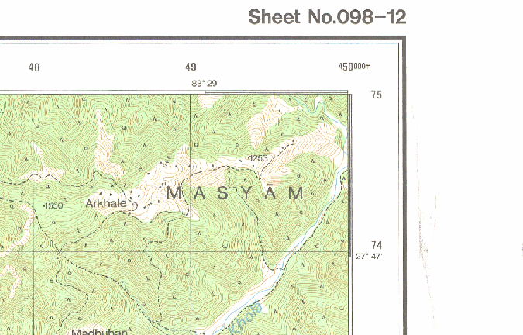
Map Elements
Marginal information
Neat line
Frame line
border
Map face

Slide 32
Marginal information
Marginal information – additional information to use map properly
Map title
Sheet No.
How and when the map was made
statement of scale and scale line
Legend
Contour interval
Sheet index
Declination figure
Sheet history
Copy rights etc

Slide 33
Map Characteristics
1.Maps provide answers ( in graphical form ) to questions related to:
Geographic location
Thematic attributes
Time

Slide 34
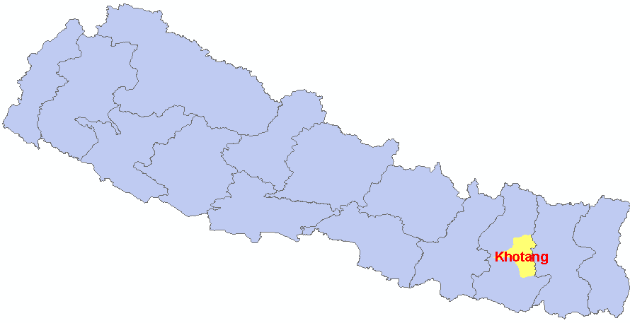
Geographic Location : where is Khotang?

Slide 35
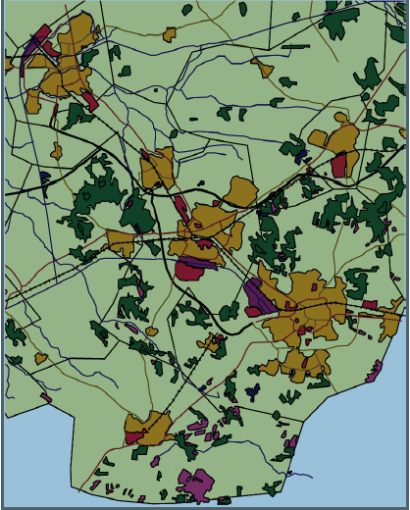
Thematic attributes: what are the types of land use?

Slide 36
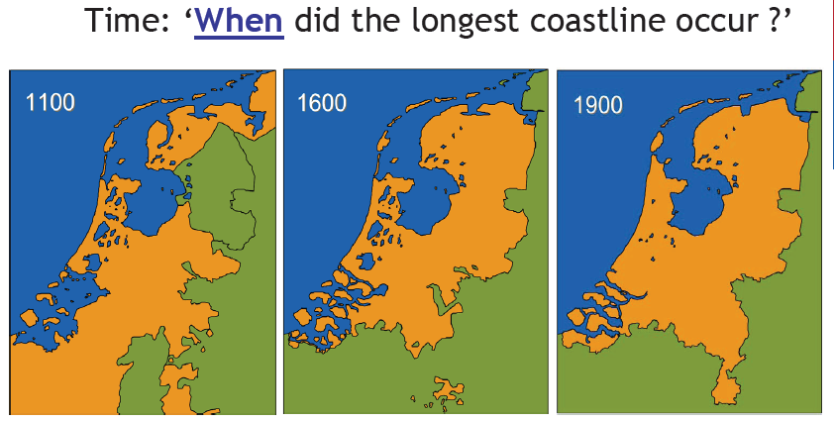

Slide 37
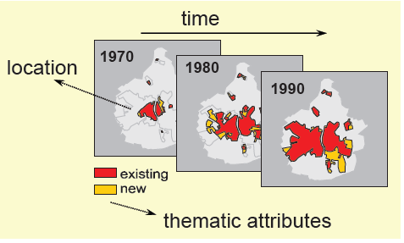
Each of these questions refers to a specific component of geographic data:
Where – geographic location
What – thematic attributes
When - time

Slide 38
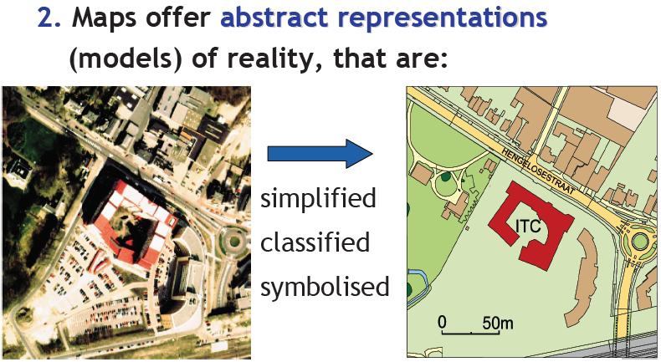
Map Characteristics

Slide 39
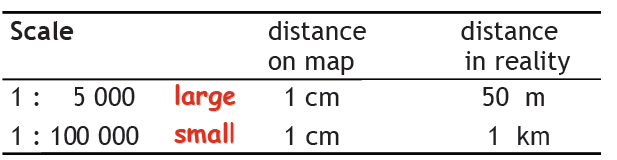
Map characteristics
3. Maps are represented at scale.

Slide 40
Classification of maps
Purpose of map classification is systematic study, storing, accuracy analysis and information extraction.
Basic characteristics of map classification are mapped area, map scale, map content and map purpose.
On the basis of scale – small scale ( 1: 500000 to 1: 100000 ) , medium scale ( 1: 50000 to 1: 25000) and large scale ( 1: 10000 and larger – adopted by SD of Nepal.

Slide 41
Classification of maps
On the basis of major contents of map – general geographic and thematic maps.
General geographic maps show the general ground features like hydrology, relief, settlements, transportation, vegetation etc., eg. Topographic maps.
Thematic maps are dedicated to specific theme viz. settlements, climate, soil, transportation, education, population, land use, geology, economy etc.

Slide 42
Classification of maps
on the basis of map purpose:
scientific purpose map
educational map
sea and air navigation map
cadastral map
transportation map
tourist map

Slide 43
Classification of maps
digital map can be analogue and virtual map
Analogue map
analogue map is hard copy map usually printed on paper
visible and tangible
virtual map
type 1 – map in the computer moniter which is visible but not tangible
type 2 – map in floppy, CD or other storage device are tangible but not visible
type 3 – maps neither visible nor tangible, maps available in WWW.

Slide 44
Use of maps
People have used maps for centuries to represent their environment. maps are used to show locations, distances, directions, and size of the areas. Maps also display geographic relationship, differences, clusters, and patterns. maps are used for navigation, exploration, illustration, and communication in the public and private sectors. Nearly every area of scientific enquiry uses maps in some form or another.

Slide 45
Use of maps
Maps are indispensable tool for many aspects of professional and academic work.
Scientists can discover the trend of certain phenomena after visualizing it in the map.
teaching professionals feel comfortable to explain about geography and environment with the help of maps.
for tourists map is very kin friend to plan his tour and find out the interesting place to visit.
planners take decision on the basis of map.
emergency service providers use maps to find the place where the event has occurred and find out the optimum ways to deliver the services.

Slide 46
Use of maps
engineers use maps for constructions of different structures.
with maps it is quite comfortable to conduct , monitor and evaluate big operations like census.
maps are useful for disaster prevention and management.
In our daily life it has been quite popular to attach a location map in the invitation cards.

Slide 47
Map Scale
One of the main objectives of map making is to visualize the features of greater area in a small and comfortable to use form and size.
maps are always prepared in reduced form
scale of map is the degree of reduction between the real world and its representation in the map
Map scale can be expressed either in verbal description ( such as 1 cm to 1 km) , representative frction ( like 1 : 10000) or graphically ( bar scale or scale line). The function of scale line is to graphically convert measurements made on maps into ground distance. Bar scale quite fits in digital environments.

Slide 48
Map scale
A strict formal relation exists between the represented area, the map format (sheet size) and its scale.. When two of the three aspects are predetermined, third one is compulsory. For example: a given area of 8 * 5 km² and an A4 paper format will result in a map at 1:50000 scale.
When scale is changed (large to small) all information can not be incorporated in small scale maps. Maps are to be generalized.(selection, aggregation, simplification etc.)

Slide 49
Map Scale
Scale reduction and enlargement
Scale of map has to be reduced to cover larger area in same format.
Scale can be reduced or enlarged either using pantograph, photographic reduction, proportional divider or using radial distance. But in digital environment scale change is quite easy.
Scale 1: 1250 is 4 times larger than 1: 5000 and 1: 50000 is half the scale of 1: 25000.
The reduction or enlargement is normally stated as a percentage. Reduction to 50% means halving the scale and to 25% a quartering of the scale.

Slide 50
Map Scale
Scale reduction and Enlargement
reduction percentage = (desired scale : present scale ) * 100
if a map at 1:10000 is to be reduced to 1: 25000, the reduction percentage = (1: 25000 : 1: 10000 ) * 100 = 40%
Enlargement percentage is always more than 100%. if a scale of 1: 12,500 is to be enlarged to 1: 10000, then enlargement percentage is ……

Slide 51
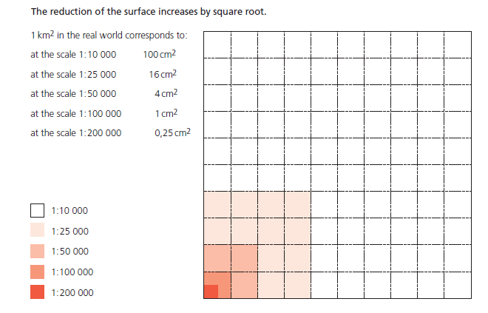
Map Scale

